Slide 1
SETS

Slide 2
Set
A set is an unordered collection of objects, called elements or members of the set.
We write a ∈ A to denote that a is an element of the set A.
The notation a ∈ A denotes that a is not an element of the set A
It is common for sets to be denoted using uppercase letters. Lowercase letters are usually
used to denote elements of sets.

Slide 3
Ways to describe a set
Roster method list all the members of a set.
Examples:
The set V of all vowels in the English alphabet can be written as V ={a, e, i, o, u}.
The set O of odd positive integers less than 10 can be expressed by O ={1, 3, 5, 7, 9}.
Although sets are usually used to group together elements with common properties, there is nothing that prevents a set from having seemingly unrelated elements. For instance, {a, 2 , Fred, New Jersey} .is the set containing the four elements a , 2, Fred, and New Jersey.

Slide 4
Ways to describe a set
Set builder notation characterize all elements in the set by stating the property or properties they must have to be members.
Examples:
The set O of all odd positive integers less than 10
O ={x | x is an odd positive integer less than 10 }
Specifying the universe as the set of positive integers less than 10
O ={x ∈ Z⁺| x is odd and x< 10}.

Slide 5
Important Sets
N = {0,1,2,3,…}, the set of natural numbers
Z = { …, -2, -1, 0, 1, 2,3, …), the set of integers
Z⁺ = {1,2,3,…} set of positive integers
Q = {p/q | p ∈ Z, q ∈Z, and q≠0}, set of rational numbers
Q ⁺={x ∈ R | x =p/q, for some positive integers p and q }.
R, the set of real numbers.
R+, the set of positive real numbers
C, the set of complex numbers .
Note: Real number are the numbers that can be represented by an infinite decimal representation, such as 3.4871773339…. The real numbers include both rational, and irrational numbers and can be represented as points along an infinitely long number line.

Slide 6
Recall the notation for intervals of real numbers.
When a and b are real numbers with a<b, we write
[a, b ]={x | a ≤ x ≤ b }
[a, b) ={x | a ≤ x<b}
(a, b ]={x | a<x≤ b }
(a, b) ={x | a<x<b}
Note that [a, b ] is called the closed interval from a to b and (a, b) is called the open interval from a to b .

Slide 7
Two sets are equal if and only if they have the same elements. Therefore, if A and B are sets, then A and B are equal if and only if
∀x(x ∈ A ↔x ∈ B).
We write A = B if A and B are equal sets.
Example:
{1, 3, 5} and {3, 5, 1}
{1, 3, 3, 3, 5, 5, 5, 5} and {1, 3, 5}

Slide 8
The Empty Set
A special set that has no elements. This set is called the empty set, or null set, and is denoted by ∅. The empty set can also be denoted by {}.
A set with one element is called a singleton set.
A common error is to confuse the empty set∅ with the set {∅}, which is a singleton set.

Slide 9
Venn Diagrams
Sets can be represented graphically using Venn diagrams, named after the English mathematician John Venn.
In Venn diagrams the universal set U, which contains all the objects under consideration, is represented by a rectangle.
Inside this rectangle, circles or other geometrical figures are used to represent sets points are used to represent the particular elements of the set.

Slide 10
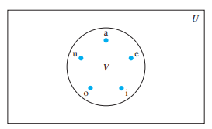
Venn Diagrams…
Example:
Draw a Venn diagram that represents V, the set of vowels in the English alphabet.

Slide 11
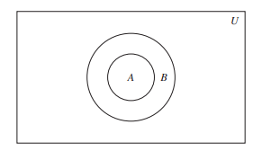
Subsets
The set A is a subset of B if and only if every element of A is also an element of B .
The notation A ⊆ B is used to indicate that A is a subset of the set B .
A ⊆ B if and only if the quantification
∀x(x ∈ A →x ∈ B) is true.
To show that A is not a subset of B we need only find one element x ∈ A with x∈ B .

Slide 12
Subsets…
Examples:
The set of all odd positive integers less than 10 is a subset of the set of all positive integers.

Slide 13
Subsets…
Theorem: Every nonempty set S is guaranteed to have at least two subsets, the empty set and the set S itself, that is, ∅⊆ S and S ⊆ S .

Slide 14
Proper Subset
If set A is a subset of a set B but that A ≠ B, we write A ⊂ B and say that A is a proper subset of B.
For A ⊂ B to be true, it must be the case that
A ⊆ B and there must exist an element x of B that is not an element of A.
That is, A is a proper subset of B if and only if
∀x(x ∈ A →x ∈ B)∧∃x(x ∈ B ∧ x ∈ A) is true.

Slide 15
The Size of a Set
Let S be a set. If there are exactly n distinct elements in S where n is a nonnegative integer, we say that S is a finite set and that n is the cardinality of S . The cardinality of S is denoted by |S |.
Examples:
A be set of odd positive integers less than 10.
Then |A|= 5.
S be the set of letters in the English alphabet.
Then |S |= 26.
Because the null set has no elements, it follows that
|∅| = 0

Slide 16
Infinite Set
A set is said to be infinite if it is not finite.
Example:
The set of positive integers is infinite.

Slide 17
Power Sets
Given a set S , the power set of S is the set of all subsets of the set S. The power set of S is
denoted by P(S).
Example:
What is the power set of {0,1,2}?
P ({0 , 1, 2 }) ={∅, {0 }, {1}, {2 }, {0 , 1}, {0 , 2 }, {1, 2 }, {0 , 1, 2 }} .
What is the power set of the empty set?
P (∅) = {∅}.
What is the power set of the set{∅}?
P ({∅}) ={∅, {∅}} .

Slide 18
Cartesian Products
The ordered n-tuple(a1, a2,...,an) is the ordered collection that has a1 as its first element, a2 as its second element ,...,and an as its n^{th} element.
We say that two ordered n-tuples are equal if and only if each corresponding pair of their elements is equal. In other words, (a1,a2,...,an) = (b1,b2,...,bn) if and only if ai = bi ,for i = 1, 2 ,...,n .
Example:
The ordered pairs (a, b) and (c, d) are equal if and only if a = c and b = d .

Slide 19
Cartesian Products..
Let A and B be sets. The Cartesian product of A and B , denoted by A × B , is the set of all ordered pairs(a, b), where a ∈ A and b ∈ B .
A × B ={(a, b) | a ∈ A ∧ b ∈ B }.
The Cartesian products A × B and B × A are not equal, unless A =∅or B =∅ or A = B
Example:
What is the Cartesian product of A ={1, 2 } and B ={a, b, c}?
A × B ={(1, a), (1, b), (1, c), (2 , a), (2 , b), (2 ,c)}.
B × A ={(a, 1), (a,2 ), (b,1), (b,2 ), (c,1), (c,2 )}.

Slide 20
Cartesian Products…
What is the Cartesian product A × B × C , where A ={0 , 1}, B ={1, 2 }, and C ={0 , 1, 2 } ?
A × B × C ={(0 , 1, 0 ), (0 , 1, 1), (0 , 1, 2 ), (0 , 2 , 0 ), (0 , 2 , 1), (0 , 2 , 2 ), (1, 1, 0 ), (1, 1, 1), (1, 1, 2 ), (1, 2 , 0 ), (1, 2 , 1), (1, 2 , 2 )}.

Slide 21
Cartesian Products…
The notationA² to denote A × A.
The Cartesian product of the set A with itself.
A³= A × A × A,
A⁴= A × A × A × A, and so on.
Example:
Let A ={1, 2 }. Find A²
A²={(1, 1), (1, 2 ), (2 , 1), (2 , 2 )}
Find A³
= {(1, 1, 1), (1, 1, 2 ), (1, 2 , 1), (1, 2 , 2 ), (2 , 1, 1),
(2 , 1, 2 ), (2 , 2 , 1), (2 , 2 , 2 )}.

Slide 22
Cartesian Products…
A subset R of the Cartesian product A × B is called a relation from the set A to the set B .
The elements of R are ordered pairs, where the first element belongs to A and the second to B .
Example, R ={(a, 0 ), (a,1), (a,3), (b,1), (b,2 ), (c,0 ), (c,3)} is a relation from the set{a, b, c} to the set {0 , 1, 2 , 3}.
A relation from a set A to itself is called a relation on A.

Slide 23
Cartesian Products…
Example:
What are the ordered pairs in the less than or equal to relation, which contains(a, b) if a ≤ b , on the set {0 , 1, 2 , 3}?
The ordered pair (a, b) belongs to R if and only if both a and b belong to {0 , 1, 2 , 3} and a ≤ b .
The ordered pairs in R are:
(0,0), (0,1), (0,2), (0,3), (1,1), (1,2), (1,3),
(2,2), (2, 3), and (3, 3).

Slide 24
Assignment
Exercise 2.1
1
7
11
15
19
21
32
33
35
37

Slide 25
SET OPERATIONS

Slide 26
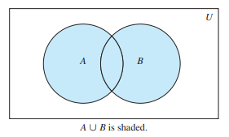
Union
Let A and B be sets. The union of the sets A and B , denoted by A ∪ B , is the set that contains those elements that are either in A or in B , or in both.
An element x belongs to the union of the sets A and B if and only if x belongs to A or x belongs to B .
Example
Union of sets {1, 3, 5} and {1, 2 , 3}
{1, 3, 5}∪{ 1, 2 , 3}={1, 2 , 3, 5}
A ∪ B ={x | x ∈ A ∨ x ∈ B }

Slide 27
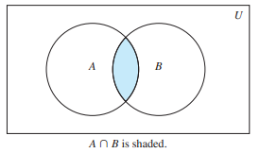
Intersection
Let A and B be sets. The intersection of the sets A and B , denoted by A ∩ B , is the set containing those elements in both A and B .
An element x belongs to the intersection of the sets A and B if and only if x belongs to A and x belongs to B .
Example:
Intersection of sets
{1, 3, 5} and {1, 2 , 3}
{1, 3, 5}∩{ 1, 2 , 3}={1, 3}.
A ∩ B ={x | x ∈ A ∧ x ∈ B

Slide 28
Cardinality of Union
The generalization of this result to unions of an arbitrary number of sets is called the principle of inclusion–exclusion.
The principle of inclusion–exclusion is an important technique used in enumeration.
|A ∪ B |=| A|+| B |−| A ∩ B |

Slide 29
Disjoint
Two sets are called disjoint if their intersection is the empty set
Example
Let A ={1, 3, 5, 7, 9} and B ={2 , 4 , 6, 8, 10}.
Because A ∩ B =∅
A and B are disjoint.

Slide 30
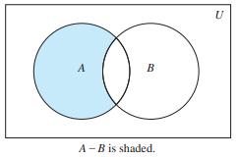
Difference
Let A and B be sets. The difference of A and B, denoted by A − B, A\B or is the set containing those elements that are in A but not in B .
The difference of A and B is also called the complement of B with respect to A .
An element x belongs to the difference of A and B if and only if x ∈ A and x∈ B .
Example:
The difference of{1, 3, 5} and {1, 2 , 3}
{1, 3, 5}−{ 1, 2 , 3}={5}.
The difference of {1, 2 , 3} and {1, 3, 5}
{1, 2, 3}−{ 1, 3 , 5}={2}.
A − B ={x | x ∈ A ∧ x∈ B }.

Slide 31
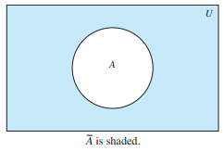
Complement
Let U be the universal set. The complement of the set A, denoted by Ā, is the complement of A with respect to U . Therefore, the complement of the set A is U − A.
An element belongs to Ā if and only if x∈ A.
Example:
Let A ={a, e, i, o, u}.Find Ā
Ā ={b, c, d, f, g, h, j, k, l, m, n, p,
q, r, s, t,v , w ,x,y,z}.
Ā ={x ∈ U | x∈ A}

Slide 32
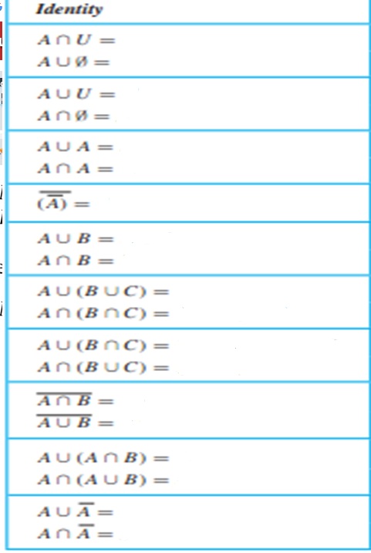
Set Identities

Slide 33
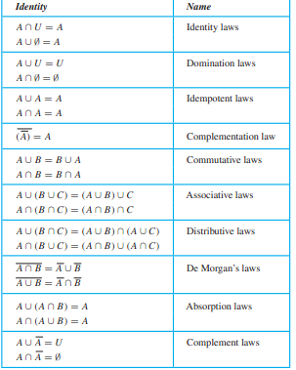
Set Identities

Slide 34

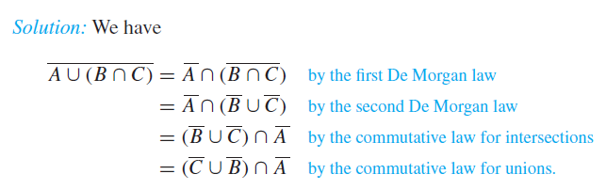
Example

Slide 35
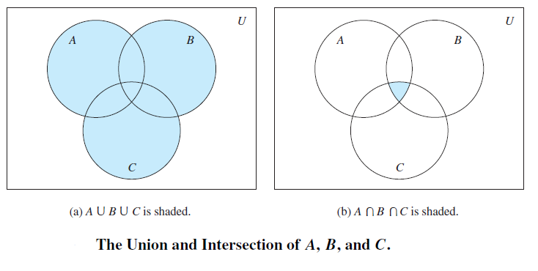
Generalized Unions and Intersections

Slide 36
Example
Let A = {0, 2, 4, 6, 8}, B = {0, 1, 2, 3, 4}, and
C = {0, 3, 6, 9}. What are A ∪ B ∪ C and
A ∩ B ∩ C?
Solution:
A ∪ B ∪ C = {0, 1, 2, 3, 4, 6, 8, 9}.
A ∩ B ∩ C = {0}.

Slide 37
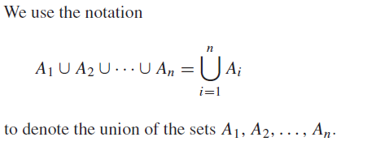
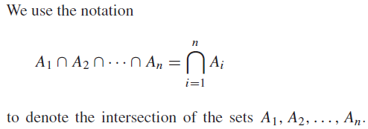

Slide 38
Computer Representation of Sets
Assume that the universal set U is finite.
Specify an arbitrary ordering of the elements of U, for instance a1, a2, . . . , an.
Represent a subset A of U with the bit string of length n, where the i^{th} bit in this string is 1 if a_{i} belongs to A and is 0 if a_{i} does not belong to A.

Slide 39
Example
Let U = {1, 2, 3, 4, 5, 6, 7, 8, 9, 10}, and the ordering of elements of U has the elements in increasing order; that is, a_{i} = i.
What bit strings represent the subset of all odd integers in U, the subset of all even integers in U, and the subset of integers not exceeding 5 in U?
Solution:
The bit string that represents the set of odd integers in U, namely, {1, 3, 5, 7, 9},
10 1010 1010.
The subset of all even integers in U, namely, {2, 4, 6, 8, 10},
01 0101 0101.
The set of all integers in U that do not exceed 5, namely, {1, 2, 3, 4, 5}
11 1110 0000.

Slide 40
Example…
For the set {1, 3, 5, 7, 9} (with universal set {1, 2, 3, 4,5, 6, 7, 8, 9, 10}) .What is the bit string for the complement of this set?
Solution:
01 0101 0101

Slide 41
Example…
The bit strings for the sets {1, 2, 3, 4, 5} and {1, 3, 5, 7, 9} are 11 1110 0000 and 10 1010 1010,
respectively. Use bit strings to find the union and intersection of these sets.
Solution:
The bit string for the union of these sets is
11 1110 0000 ∨ 10 1010 1010 = 11 1110 1010,
which corresponds to the set {1, 2, 3, 4, 5, 7, 9}.
The bit string for the intersection of these sets is
11 1110 0000 ∧ 10 1010 1010 = 10 1010 0000,
which corresponds to the set {1, 3, 5}.

Slide 42
Assignment
Exercise 2.2
3
14
25
27
52
53
57

Slide 43
Functions

Slide 44
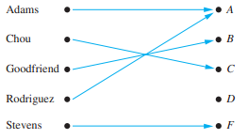
Functions
In many instances we assign to each element of a set a particular element of a second set (which may be the same as the first).
The concept of a function is extremely important in mathematics and computer science.

Slide 45
Functions…
Let A and B be nonempty sets. A function f from A to B is an assignment of exactly one
element of B to each element of A. We write f(a) = b if b is the unique element of B
assigned by the function f to the element a of A.
If f is a function from A to B , we write
f : A →B .

Slide 46
Functions…
It is a relation between a set of inputs and a set of permissible outputs with the property that each input is related to exactly one output.
Functions are sometimes also called mappings or transformations .

Slide 47
Functions…
Functions are specified in many different ways:
Explicitly state the assignments
Give a formula, such as f(x)= x + 1, to define a function.
Use a computer program to specify a function.
A function f : A →B can also be defined in terms of a
relation from A to B .
A relation from A to B is just a subset of A × B . A relation from A to B that contains one, and only one, ordered pair (a, b) for every element a ∈ A, defines a function f from A to B . This function is defined by the assignment f(a) = b , where (a, b) is the unique ordered pair in the relation that has a as its first element.

Slide 48
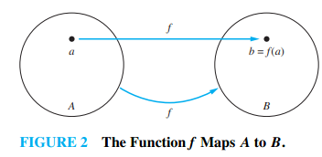
Functions…
If f is a function from A to B , we say that A is
the domain of f and B is the codomain of f.
If f(a) = b , we say that b is the image of a and a
is a preimage of b . The range, or image ,
of f is the set of all images of elements of A.
Also, if f is a function from A to B , we say
that f maps A to B .

Slide 49
Functions…
Two functions are equal when they have the same domain, have the same codomain, and map each element of their common domain to the same element in their common codomain.

Slide 50
Examples
What are the domain, codomain, and range of the function that assigns grades to students.
Domain of G is the set {Adams, Chou, Goodfriend, Rodriguez, Stevens }
Codomain is the set {A, B, C, D, F }.
Range of G is the set {A, B, C, F}, because each grade except D is assigned to some student.

Slide 51
Examples…
Let R be the relation with ordered pairs (Abdul, 22), (Brenda, 24), (Carla, 21), (Desire, 22), (Eddie, 24), and (Felicia, 22). Here each pair consists of a graduate student and this student’s age. Specify a function determined by this relation.
If f is a function specified by R , then f(Abdul) = 22, f(Brenda ) = 24, f(Carla) = 21, f(Desire) = 22, f(Eddie) = 24, and f(Felicia ) = 22. (Here, f(x)is the age of x , where x is a student.)
Domain set {Abdul, Brenda, Carla, Desire, Eddie, Felicia}.
Codomain, which needs to contain all possible ages of students. Because it is highly likely that all students are less than 100 years old, we can take the set of positive integers less than 100 as the codomain.
Range {21, 22, 24}.

Slide 52
Examples…
Let f be the function that assigns the last two bits of a bit string of length 2 or greater to that string. For example,
f(11010) = 10.
Domain of f is the set of all bit strings of length 2 or greater.
Codomain and range are the set {00, 01, 10, 11}.
Let f : Z →Z assign the square of an integer to this integer. Then, f(x)= x^{2.}
Domain of f is the set of all integers
Codomain of f is the set of all integers
Range of f is the set of all integers that are perfect squares, namely, {0 , 1, 4 , 9,... }.

Slide 53
Examples…
Java statement
int function(float x){...}
and the C++ function statement
int function (float x ){...}
Domain of the function is the set of real numbers (represented by floating point numbers) and its codomain is the set of integers.
A function is called real-valued if its codomain is the set of real numbers, and it is called
integer-valued if its codomain is the set of integers.

Slide 54
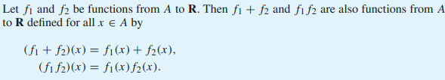
Examples…
Two real-valued functions or two integer-valued functions with the same domain can be added, as well as multiplied.

Slide 55
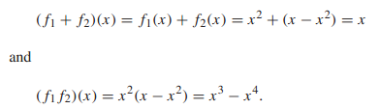
Let f₁ and f₂ be functions from R to R such that f₁(x) = x² and f₂(x) = x − x². What are the functions f₁ + f₂ and f₁ f₂?

Slide 56
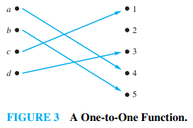
One-to-One Functions
Some functions never assign the same value to two different domain elements. These functions are said to be one-to-one.
A function f is said to be one-to-one, or an injunction, if and only if f(a) = f(b) implies that a = b for all a and b in the domain of f.
f is one-to-one if and only if f(a) ≠ f(b) whenever a ≠ b .
f is one-to-one using as ∀a ∀b(f (a) = f(b) →a = b) or equivalently ∀a ∀b(a ≠ b →f(a) ≠ f(b))

Slide 57
Examples
Determine whether the function f from {a, b, c, d } to {1, 2 , 3, 4 , 5} with f(a) = 4, f(b) = 5, f(c) = 1, and f(d)= 3 is one-to-one.
The function f is one-to-one because f takes on different values at the four elements of its domain.
Determine whether the function f(x)= x² from the set of integers to the set of integers is one-to-one.
The function f(x)= x² is not one-to-one because, for instance, f(1) = f(−1) = 1, but 1≠−1.

Slide 58

Onto Functions
For some functions the range and the codomain are equal. That is, every member of the codomain is the image of some element of the domain.
Functions with this property are called onto functions.

Slide 59
Examples
Let f be the function from {a, b, c, d } to {1, 2 , 3} defined by f(a) = 3, f(b) = 2, f(c) = 1 and f(d)= 3. Is f an onto function?
Because all three elements of the codomain are images of elements in the domain, we see that f is onto.
If the codomain were {1, 2 , 3, 4 }, then f would not be onto.
Is the function f(x)= x² from the set of integers to the set of integers onto?
The function f is not onto because there is no integer x with x² =−1, for instance.

Slide 60
One-to-One correspondence, or a Bijection Function
The function f is a one-to-one correspondence, or a bijection, if it is both one-to-one and onto. We also say that such a function is bijective.
Example: Let f be the function from {a, b, c, d } to {1, 2 , 3, 4 } with f(a) = 4, f(b) = 2, f(c) = 1, and f(d)= 3. Is f a bijection?
The function f is one-to-one because no two values in the domain are assigned the same function value.
It is onto because all four elements of the codomain are images of elements in the domain.
Hence, f is a bijection.

Slide 61
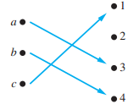
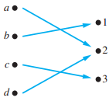
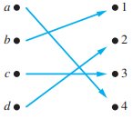



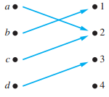
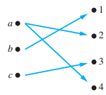

Examples of Different Types of Correspondences

Slide 62
Identity function
Let f is a function from a set A to itself. If A is finite, then f is one-to-one if and only if it is onto.
Let A be a set. The identity function on A is the function ιA: A →A, where ιA(x) = x for all x ∈ A. In other words, the identity function ιA is the function that assigns each element to itself. The function ιA is one-to-one and onto, so it is a bijection.
(Note that ι is the Greek letter iota.)

Slide 63
Inverse Functions
Let f be a one-to-one correspondence from the set A to the set B . The inverse function of f is the function that assigns to an element b belonging to B the unique element a in A such that f(a) = b . The inverse function of f is denoted by f⁻¹.
Hence, f⁻¹(b) = a when f(a) = b .
Be sure not to confuse the function f⁻¹ with the function 1/f , which is the function that assigns to
each x in the domain the value 1/f (x) .

Slide 64
A one-to-one correspondence is called invertible because we can define an inverse of this function. A function is not invertible if it is not a one-to-one correspondence, because the
inverse of such a function does not exist.

Slide 65
Examples…
Let f be the function from {a, b, c} to {1, 2 , 3} such that f(a) = 2, f(b) = 3, and f(c) = 1. Is f invertible, and if it is, what is its inverse?
The function f is invertible because it is a one-to-one correspondence. The inverse function f⁻¹ reverses the correspondence given by f ,
so f⁻¹(1) = c , f⁻¹(2 ) = a , and f⁻¹(3) = b

Slide 66
Examples..
Let f be the function from R to R with f(x)= x². Is f invertible?
Because f(−2)= f(2) = 4, f is not one-to-one. If an inverse function were defined, it would have to assign two elements to 4. Hence, f is not invertible.

Slide 67
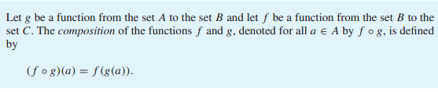
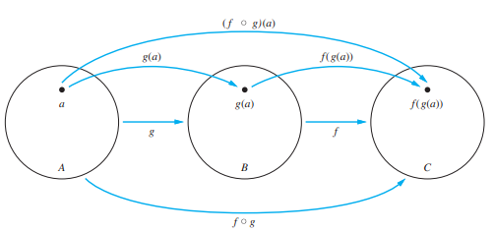
Compositions of Functions

Slide 68
Compositions of Functions…
To find (f ◦ g)(a)we first apply the function g to a to obtain g(a)
Then apply the function f to the result g(a) to obtain (f ◦ g)(a)= f(g(a)).
Note that the composition f ◦ g cannot be defined unless the range of g is a subset of the domain of f .

Slide 69
Examples
Let g be the function from the set {a, b, c} to itself such that g(a) = b , g(b) = c , and g(c) = a . Let f be the function from the set {a, b, c} to the set {1, 2 , 3} such that f(a) = 3, f(b) = 2, and f(c) = 1. What is the composition of f and g , and what is the composition of g and f .
The composition f ◦ g is defined by
(f ◦ g)(a)= f(g(a))= f(b) = 2,
(f ◦ g) (b) = f(g(b))= f(c) = 1
(f ◦ g)(c)= f(g(c))= f(a) = 3.
Note that g ◦ f is not defined, because the range of f is not a subset of the domain of g .

Slide 70
Examples..
Let f and g be the functions from the set of integers to the set of integers defined by f(x)= 2 x + 3 and g(x) = 3x + 2. What is the composition of f and g ? What is the com-position of g and f ?
Both the compositions f ◦ g and g ◦ f are defined.
(f ◦ g)(x)= f(g(x))= f(3x + 2 ) = 2 (3x + 2 ) + 3 = 6x + 7
(g◦ f )(x) =g(f (x)) =g( 2 x + 3) =3(2 x + 3)+ 2 =6x +11.
The commutative law does not hold for the composition of functions. f ◦ g and g ◦ f are not equal.

Slide 71
The Graphs of Functions

Slide 72
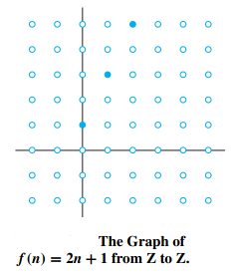
Examples..
Display the graph of the function
f (n) = 2 n + 1 from the set of integers to the set of integers.
The graph off is the set of ordered pairs of the form (n, 2 n + 1),
where n is an integer.

Slide 73
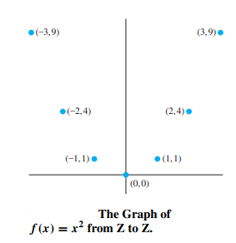
Examples..
Display the graph of the function f(x)= x²
from the set of integers to the set of integers.
The graph of f is the set of ordered pairs of the form (x, f (x)) = (x, x²), where x is an integer.

Slide 74

Some Important Functions
The floor function rounds x down to the closest integer less than or equal to x , and the ceiling function rounds x up to the closest integer greater than or equal to x .

Slide 75












Examples

Slide 76
Partial Functions
In abstract mathematics, we often want to discuss functions that are defined only for a subset of the real numbers, such as 1/x , √x , and arcsin (x).
A partial function f from a set A to a set B is an assignment to each element a in a subset of A, called the domain of definition of f , of a unique element b in B . The sets A and B are called the domain and codomain of f , respectively. We say that f is undefined for elements in A that are not in the domain of definition of f . When the domain of definition of f equals A, we say that f is a total function.

Slide 77
Example
The function f : Z →R where f (n) = √n is a partial function from Z to R where the domain of definition is the set of nonnegative integers.
f is undefined for negative integers.

Slide 78
Assignment
Exercise 2.3
1
5
9
10
11
12
13
15
23
36

Slide 79
Sequences and Summations

Slide 80
Sequences
A sequence is a discrete structure used to represent an ordered list.
For example, 1, 2, 3, 5, 8 is a sequence with five terms and 1, 3, 9, 27, 81,... ,3n,... is an infinite sequence.
We use the notation a_{n} to denote the image of the integer n. We call a_{n} a term of the sequence.

Slide 81
Example
Consider the sequence
a₁, a₂,a₃,a₄,...,
where {a_{n}},
a_{n} = 1/n
starts with
1, ½, 1/3, 1/4,....

Slide 82
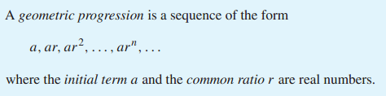
Geometric progression
A geometric progression is a discrete analogue of the exponential function f(x)=ar^{x}

Slide 83
Example
The sequences {b_{n}} with b_{n} = (−1)^{n}, , {c_{n}} with c_{n} = 2 · 5^{n}, and {d_{n}} with d_{n} = 6 · (1/3)^{n}
Are geometric progressions with initial term and common ratio equal to 1 and −1;
2 and 5;
and 6 and 1/3, respectively.
If we start at n = 0. The list of terms b0,b1,b2,b3,b4,... begins with
1, −1, 1, −1, 1,... ;
The list of terms c0,c1,c2,c3,c4,... begins with
2 , 10, 50, 250 , 1250,... ;
The list of terms d0,d1,d2,d3,d4,... begins with
6, 2 ,2/3,2/9,2/27,....

Slide 84
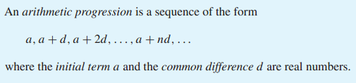
Arithmetic progression
An arithmetic progression is a discrete analogue of the linear function f(x)= dx+ a .

Slide 85
Example
The sequences {s_{n}} with s_{n} =−1 + 4 n and
{tn} with t_{n} = 7 − 3n
are both arithmetic progressions with initial terms and common differences equal to
−1 and 4,
and 7 and−3, respectively,
If we start at n = 0.
The list of terms s0,s1,s2,s3,... begins with
−1, 3, 7, 11,...,
The list of terms t0,t1,t2,t3,... begins with
7, 4 , 1, −2 ,....

Slide 86
Strings
Sequences of the form a1,a2,...,an are often used in computer science.
These finite sequences are also called strings .
The length of a string is the number of terms in this string.
The empty string , denoted by λ, is the string that has no terms.
The empty string has length zero.
Example:
The string abcd is a string of length ?
four.

Slide 87
Recurrence Relations
A recurrence relation for the sequence {a_{n}} is an equation that expresses a_{n} in terms of one or more of the previous terms of the sequence, namely, a₀,a₁,...,a_{n−1}, for all integers n with n ≥ n₀, where n₀ is a nonnegative integer.
A sequence is called a solution of a recurrence relation if its terms satisfy the recurrence relation.

Slide 88
Example…
Let {a_{n}} be a sequence that satisfies the recurrence relation a_{n} =a_{n−1} − a_{n−2} for n =2 , 3, 4 ,...,and suppose that a0 = 3 and a1 = 5. What are a₂and a₃?
The recurrence relation that
a₂ = a₁ − a₀ = 5 − 3 = 2
a₃ = a₂ − a₁ = 2 − 5 =−3
We can find a₄, a₅, and each successive term in a similar way.

Slide 89
Example
Let{a_{n}} be a sequence that satisfies the recurrence relation a_{n} = a _{n−1} + 3 for n = 1, 2 , 3,...,and suppose that a₀ = 2. What are a₁, a₂, and a₃?
The recurrence relation that
a₁ = a₀ + 3 = 2 + 3 = 5.
a₂ = 5 + 3 = 8
a₃ = 8 + 3 = 11

Slide 90


Fibonacci sequence

Slide 91
Suppose that {a_{n}} is the sequence of integers defined by a_{n} = n!, the value of the factorial function at the integer n, where n = 1, 2, 3, . . ..
Because n! = n((n − 1)(n − 2) . . . 2 ・ 1)
= n(n − 1)!
= na_{n−1}
we see that the sequence of factorials satisfies the recurrence relation
a_{n} = na_{n−1}
together with the initial condition a₁ = 1.

Slide 92
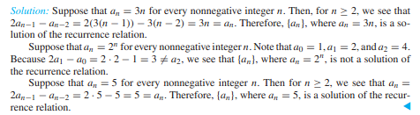
Example

Slide 93
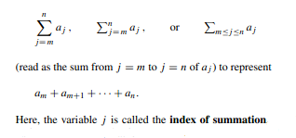
Summations
The index of summation runs through all integers starting with its lower limit m and ending with its upper limit n.

Slide 95

Example
Use summation notation to express the sum of the first 100 terms of the sequence {a_{j}}, where a_{j} = 1/j for j = 1, 2 , 3,....
The lower limit for the index of summation is 1, and the upper limit is 100. The sum is:

Slide 96

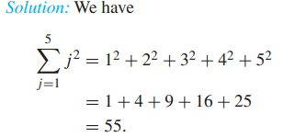
Example…

Slide 97

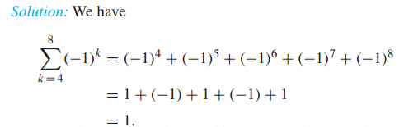
Example…

Slide 98
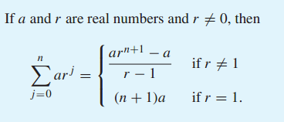

Slide 99

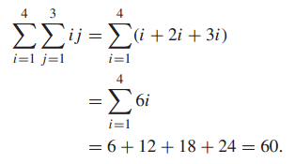
Example

Slide 100
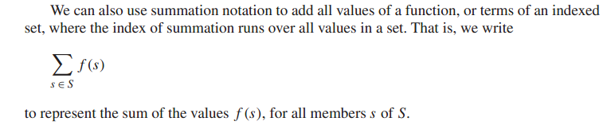

Slide 101
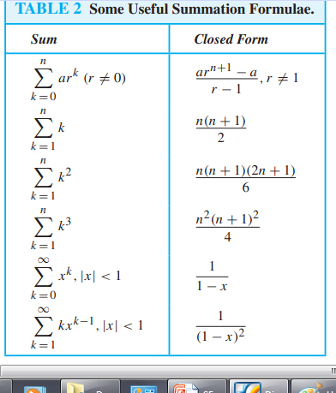

Slide 102

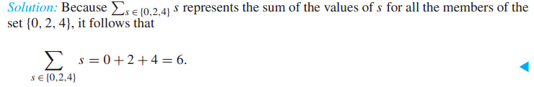
Example

Slide 103

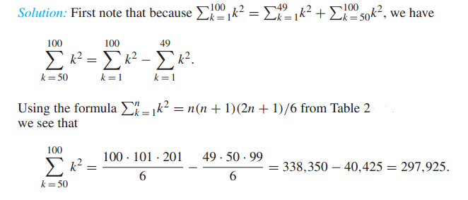
Examples…

Slide 104
Assignment
Exercise 2.4
1
2
3
9
10
13
15a,b,d
17a,b,d
29
31
33
39

Slide 105
SETS

Slide 106
Cardinality of Sets

Slide 107

Cardinality
The sets A and B have the same cardinality if and only if there is a one-to-one correspondence from A to B .
When A and B have the same cardinality, we write |A|=| B |.

Slide 108
Countable Sets
A set that is either finite or has the same cardinality as the set of positive integers is called countable.
A set that is not countable is called uncountable.
When an infinite set S is countable, we denote the cardinality of S byℵ0 (where ℵ is aleph, the first letter of the Hebrew alphabet).
We write |S |=ℵ0 and say that S has cardinality “aleph null”.

Slide 109
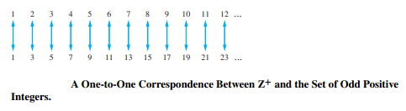
Example
Show that the set of odd positive integers is a countable set.
We will show a one-to-one correspondence between this set and the set of positive integers.
Consider the function f (n) = 2 n − 1. from Z+ to the set of odd positive integers.
We show that f is a one-to-one correspondence by showing that it is both one-to-one and onto.

Slide 110

HILBERT’S GRAND HOTEL
We describe a paradox that shows that something impossible with finite sets may be possible with infinite sets.
The famous mathematician David Hilbert invented the idea of the Grand Hotel, which has a countably infinite number of rooms, each occupied by a guest.
When a new guest arrives at a hotel with a finite number of rooms, and all rooms are occupied, this guest cannot be accommodated without evicting a current guest.
However, we can always accommodate a new guest at the Grand Hotel, even when all rooms are already occupied.

Slide 111
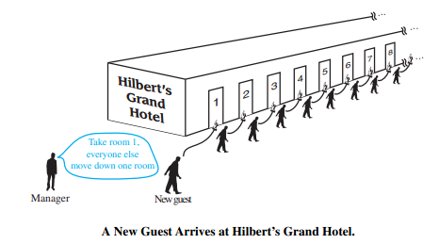
How can we accommodate a new guest arriving at the fully occupied Grand Hotel without removing any of the current guests?
Because the rooms of the Grand Hotel are countable, we can list them as Room 1,Room 2, Room 3, and so on.
When a new guest arrives, we move the guest in Room 1 to Room2, the guest in Room 2 to Room 3, and in general, the guest in Room n to Room n + 1, for all positive integers n.
This frees up Room 1, which we assign to the new guest, and all the current guests still have rooms.

Slide 112
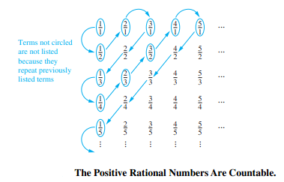
Positive Rational Numbers
Show that the set of positive rational numbers is countable.

Slide 113
Every positive rational number is the quotient p/q of two positive integers.
Arrange the positive rational numbers by listing those with denominator q = 1 in the first row, those with denominator q = 2 in the second row, and so on.
The key to listing the rational numbers in a sequence is to first list the positive rational numbers p/q with p + q = 2, followed by those with p + q = 3, followed by those with p + q = 4, and so on.
Whenever we encounter p/q that is already listed, we do not list it again.
The initial terms in the list of positive rational numbers we have constructed are 1 , 1/2 , 2 , 3, 1/3, 1/4 , 2 /3, 3/2 , 4 , 5, and so on.
Because all positive rational numbers are listed once, thus the set of positive rational numbers is countable.

Slide 114
An Uncountable Set
Show that the set of real numbers is an uncountable set.
We use an important proof method, known as the Cantor diagonalization argument, to prove that the set of real numbers is not countable.
We suppose that the set of real numbers is countable and arrive at a contradiction.
Then, the subset of all real numbers that fall between 0 and 1 would also be countable (because any subset of a countable set is also countable).
Under this assumption, the real numbers between 0 and 1 can be listed in some order, say, r1,r2,r3,....Let the decimal representation of these real numbers be

Slide 115
r1 = 0 .d11d12d13d14...................
r2 = 0 .d21d22d23d24..................
r3 = 0 .d31d32d33d34...................
r4 = 0 .d41d42d43d44..................
.
.
where dij ∈{0 , 1, 2 , 3, 4 , 5, 6, 7, 8, 9}. (For example, if r1 = 0 .23794102..., we have d11=2, d12= 3, d13= 7, and so on.)

Slide 116

Then, form a new real number with decimal expansion r = 0 .d1d2d3d4..., where the decimal digits are determined by the following rule:
As an example, suppose
r1= 0 .23794102...,
r2= 0 .44590138...,
r3= 0 .09118764...,
r4= 0.80553900..., and so on.

Slide 117
As an example, suppose
r1= 0 .23794102...,
r2= 0 .44590138...,
r3= 0 .09118764...,
r4= 0.80553900..., and so on.
Then we have r = 0 .d1d2d3d4...=0 .4544...,
where
d1 = 4 because d11≠4,
d2 = 5 because d22= 4,
d3 = 4 because d33 ≠ 4,
d4 = 4 because d44 ≠ 4, and so on.

Slide 118
Every real number has a unique decimal expansion .
Therefore, the real number r is not equal to any of r1,r2,... because the decimal expansion of r differs from the decimal expansion of ri in the i th place to the right of the decimal point, for each i .
Because there is a real number r between 0 and 1 that is not in the list, the assumption that all the real numbers between 0 and 1 could be listed must be false.
Therefore, all the real numbers between 0 and 1 cannot be listed, so the set of real numbers between 0 and 1 is uncountable.
Any set with an uncountable subset is uncountable.
Hence, the set of real numbers is uncountable.

Slide 119

Results About Cardinality
If A and B are countable sets, then A ∪ B is also countable.

Slide 120
Uncomputable Functions
We say that a function is computable if there is a computer program in some programming
language that finds the values of this function. If a function is not computable we say it is
Uncomputable.

